Slide 1
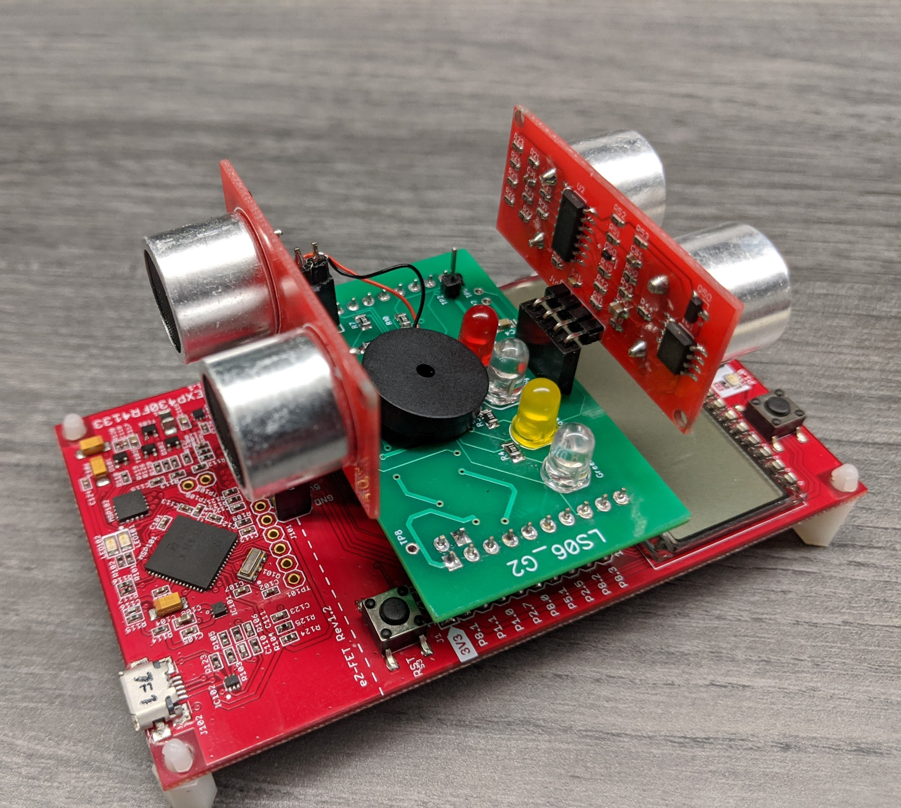
Project 1:
Bicycle Sensor
Lab Section 6, Group 2
Waleed Ahmed
Muhammad Shah

Slide 2
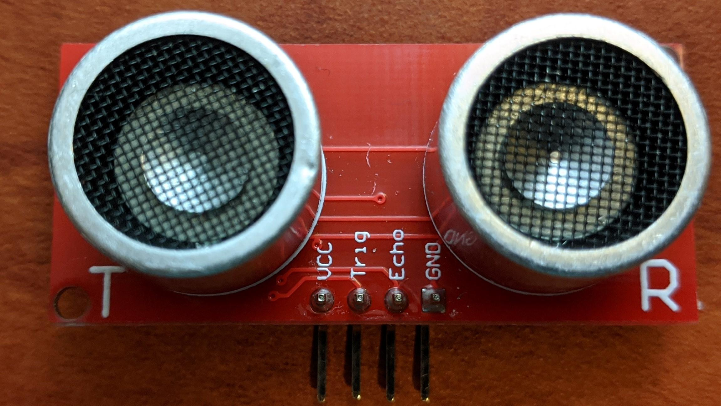
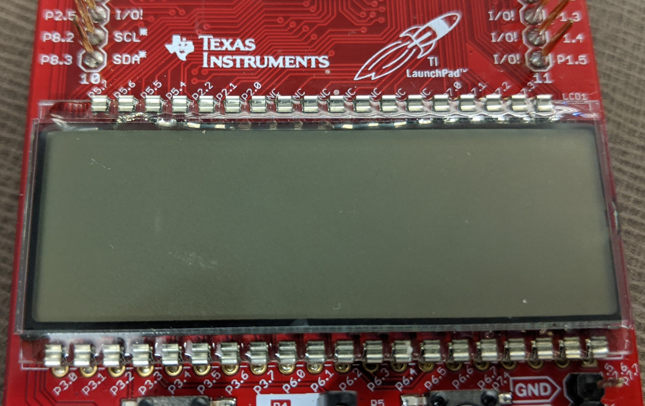
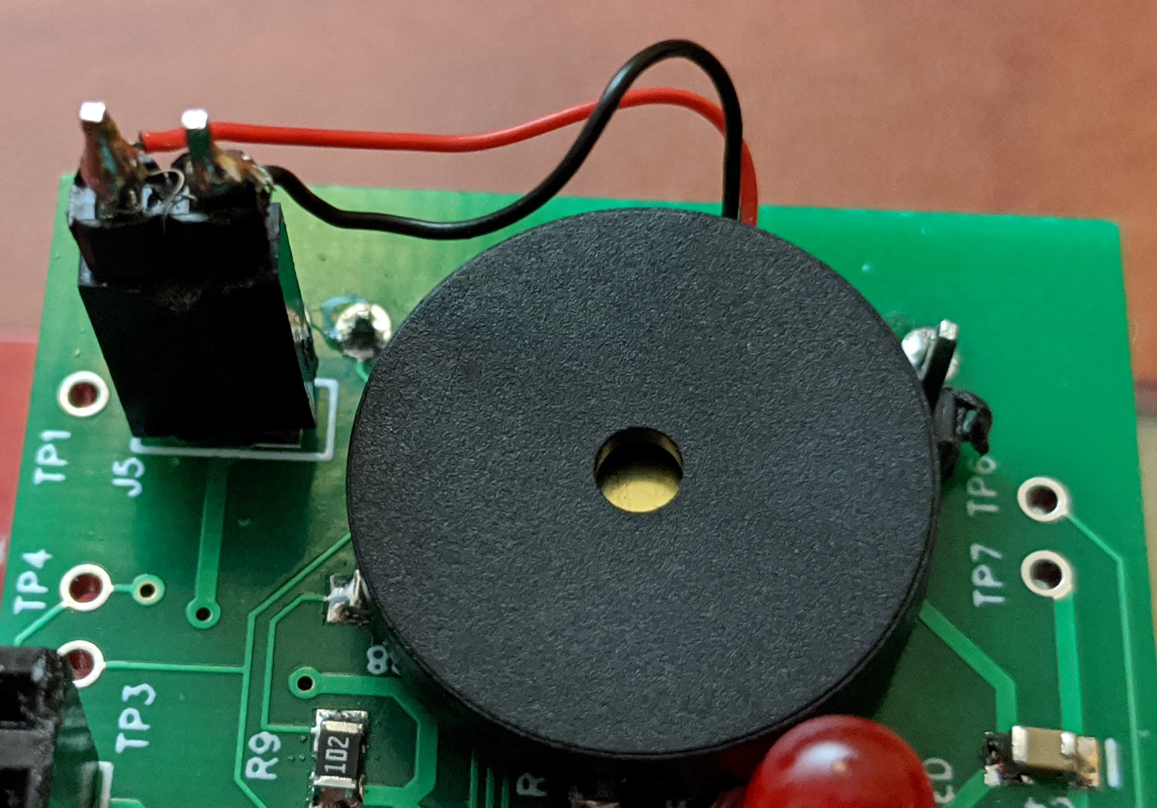
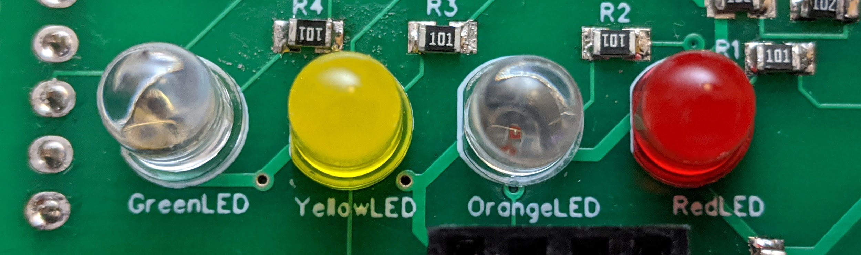
Concept and Design Goals
Forward and rear facing ultrasonic sensors
Indication of distance for both directions in cm on an LCD
Configurable proximity thresholds for both directions
Indication of when proximity thresholds are hit
Rear: LEDs
Forward: Buzzer

Slide 3
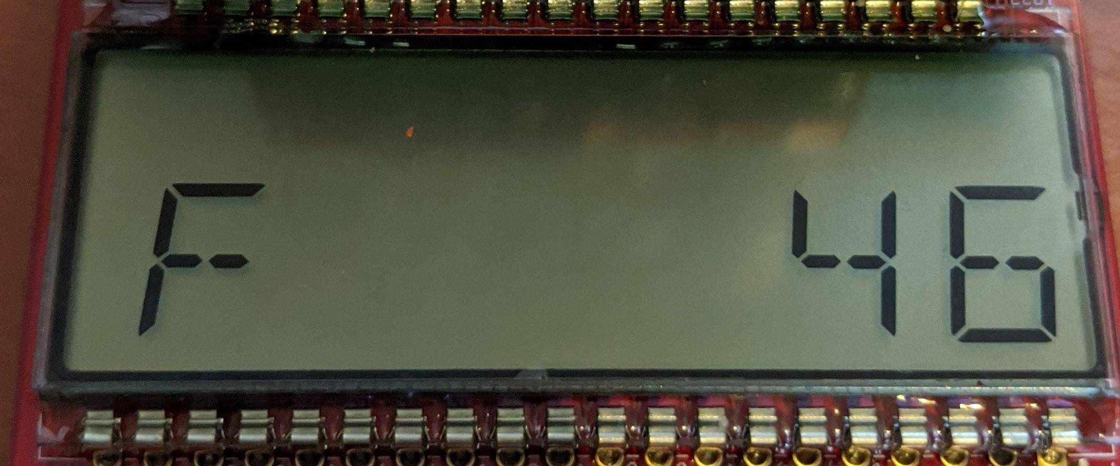
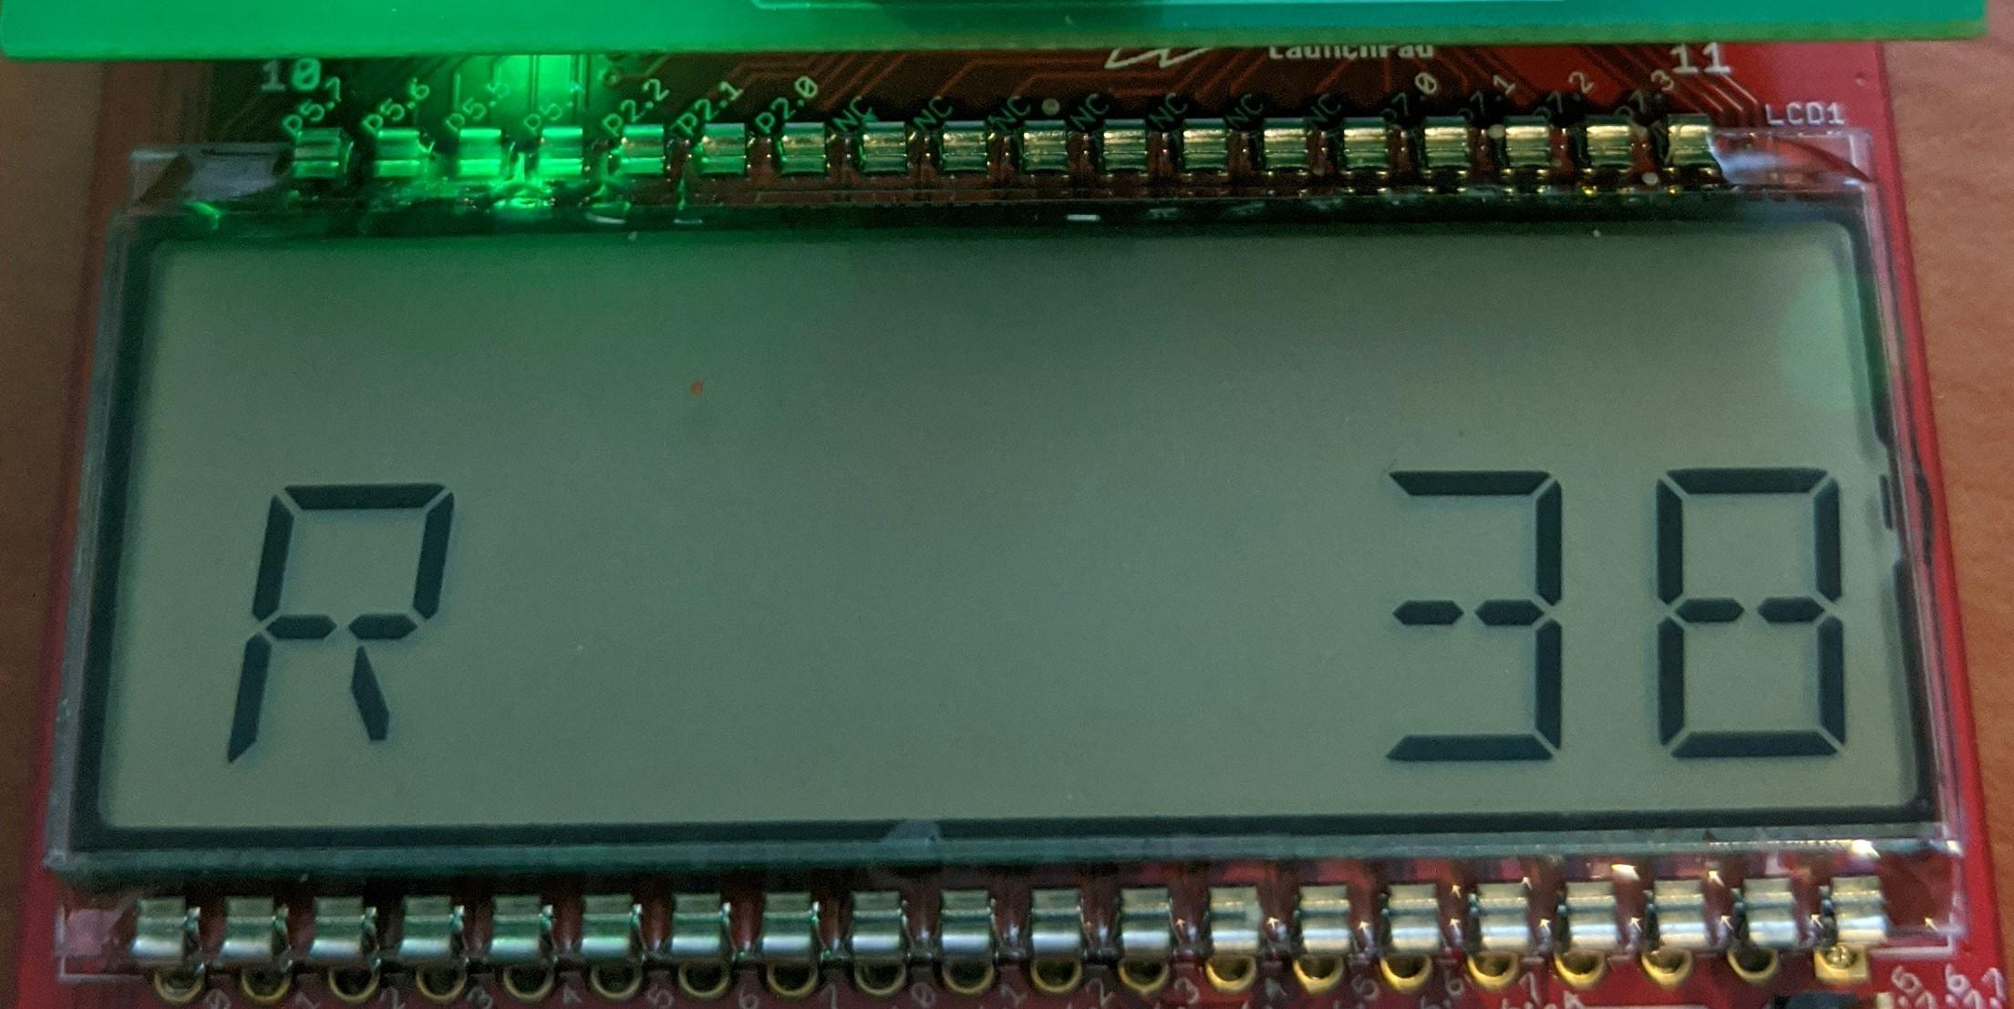
Sensors and LCD
Ultrasonic sensor for both directions
Direction and proximity (cm) displayed on LCD
Notes:
Adding design goals and how we achieved them

Slide 4
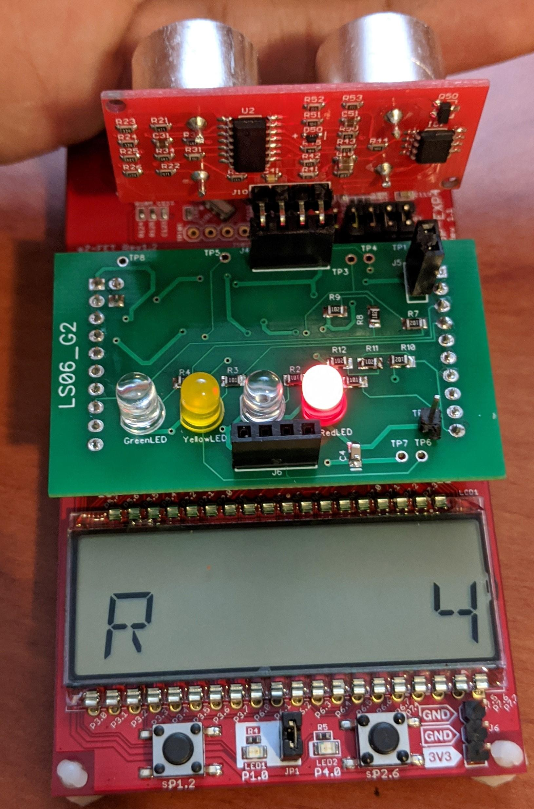
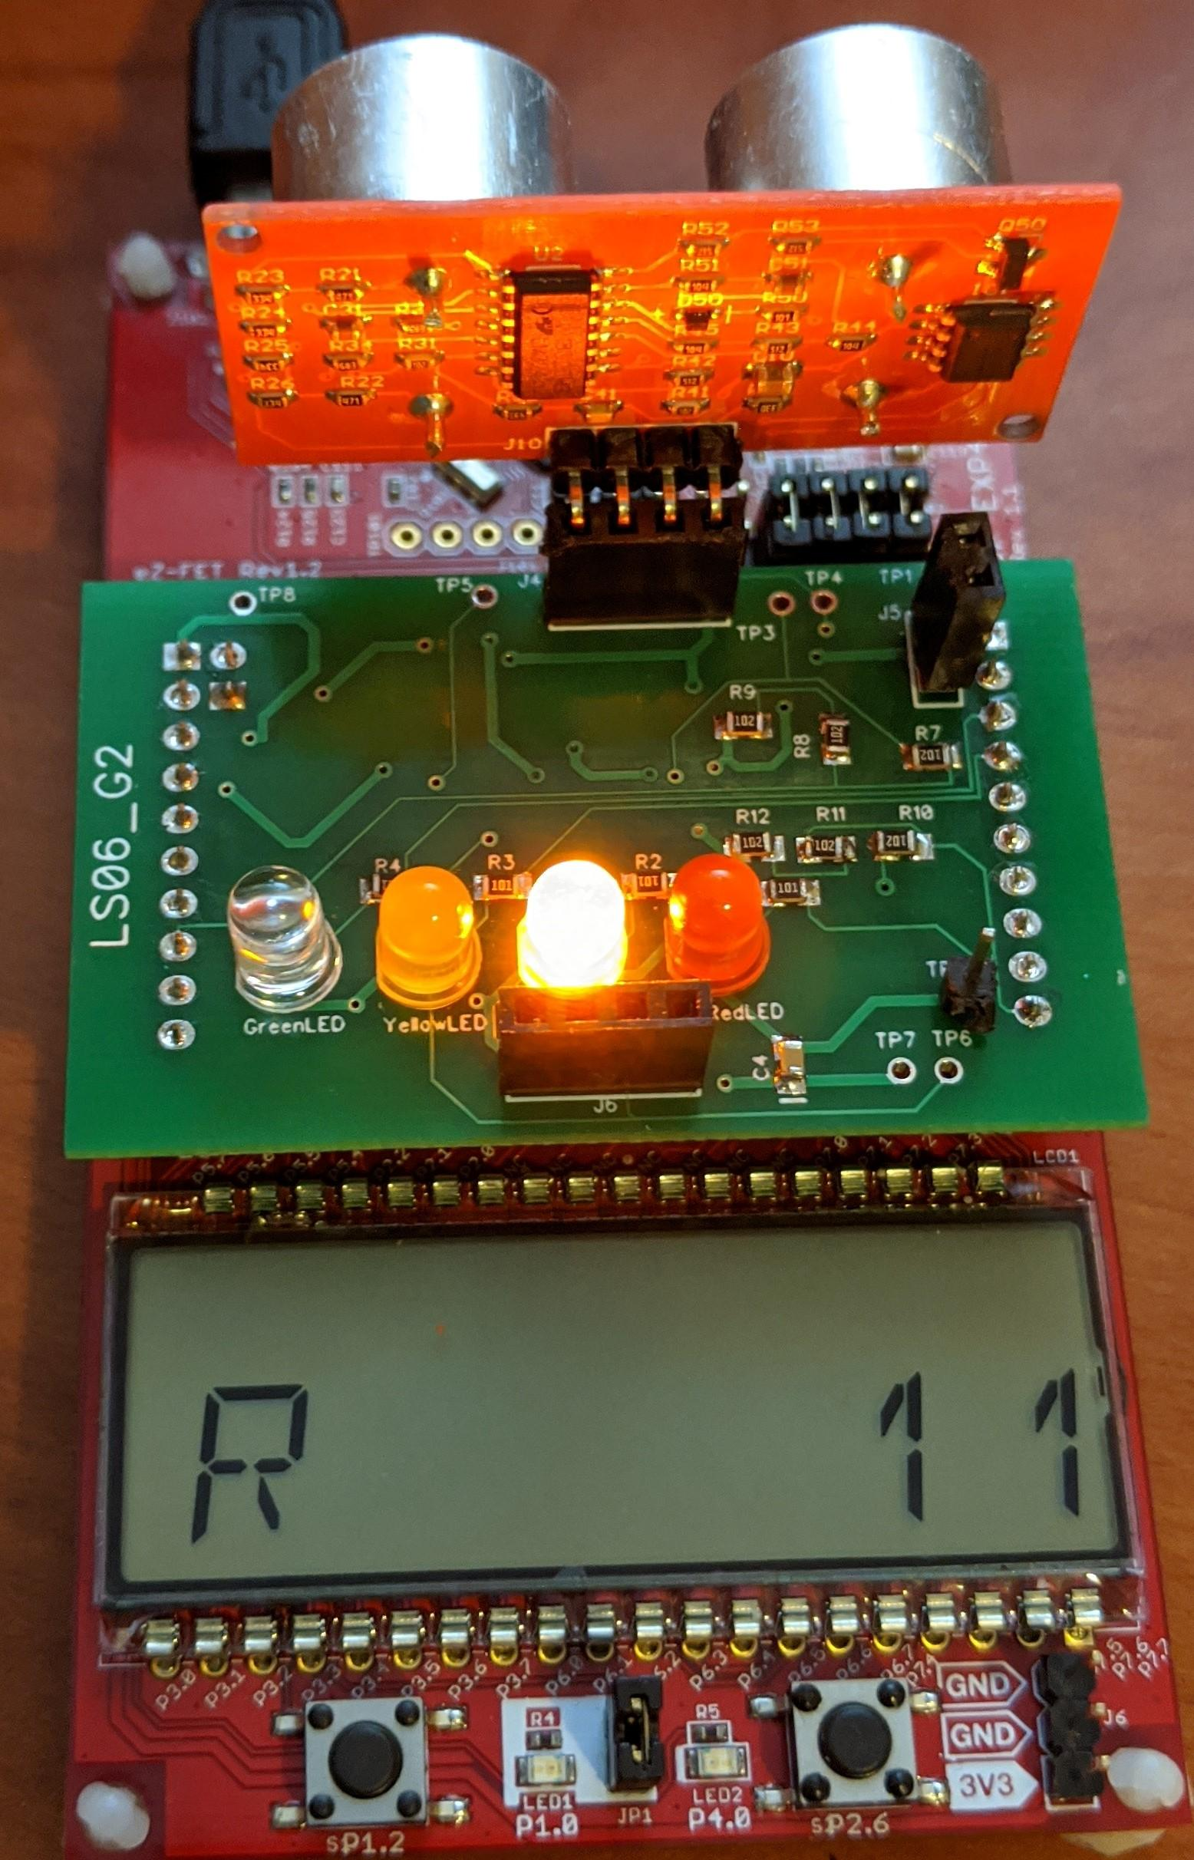
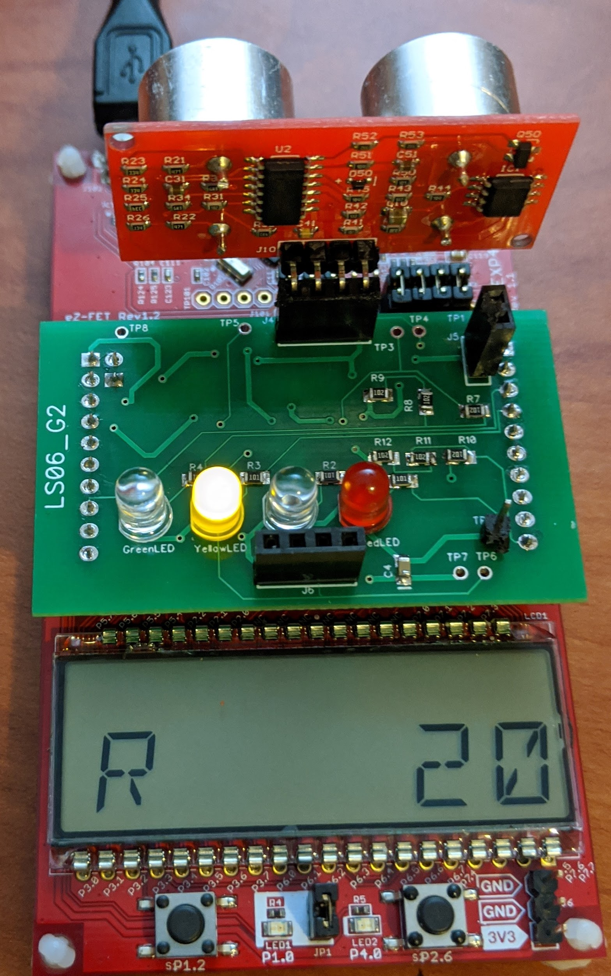
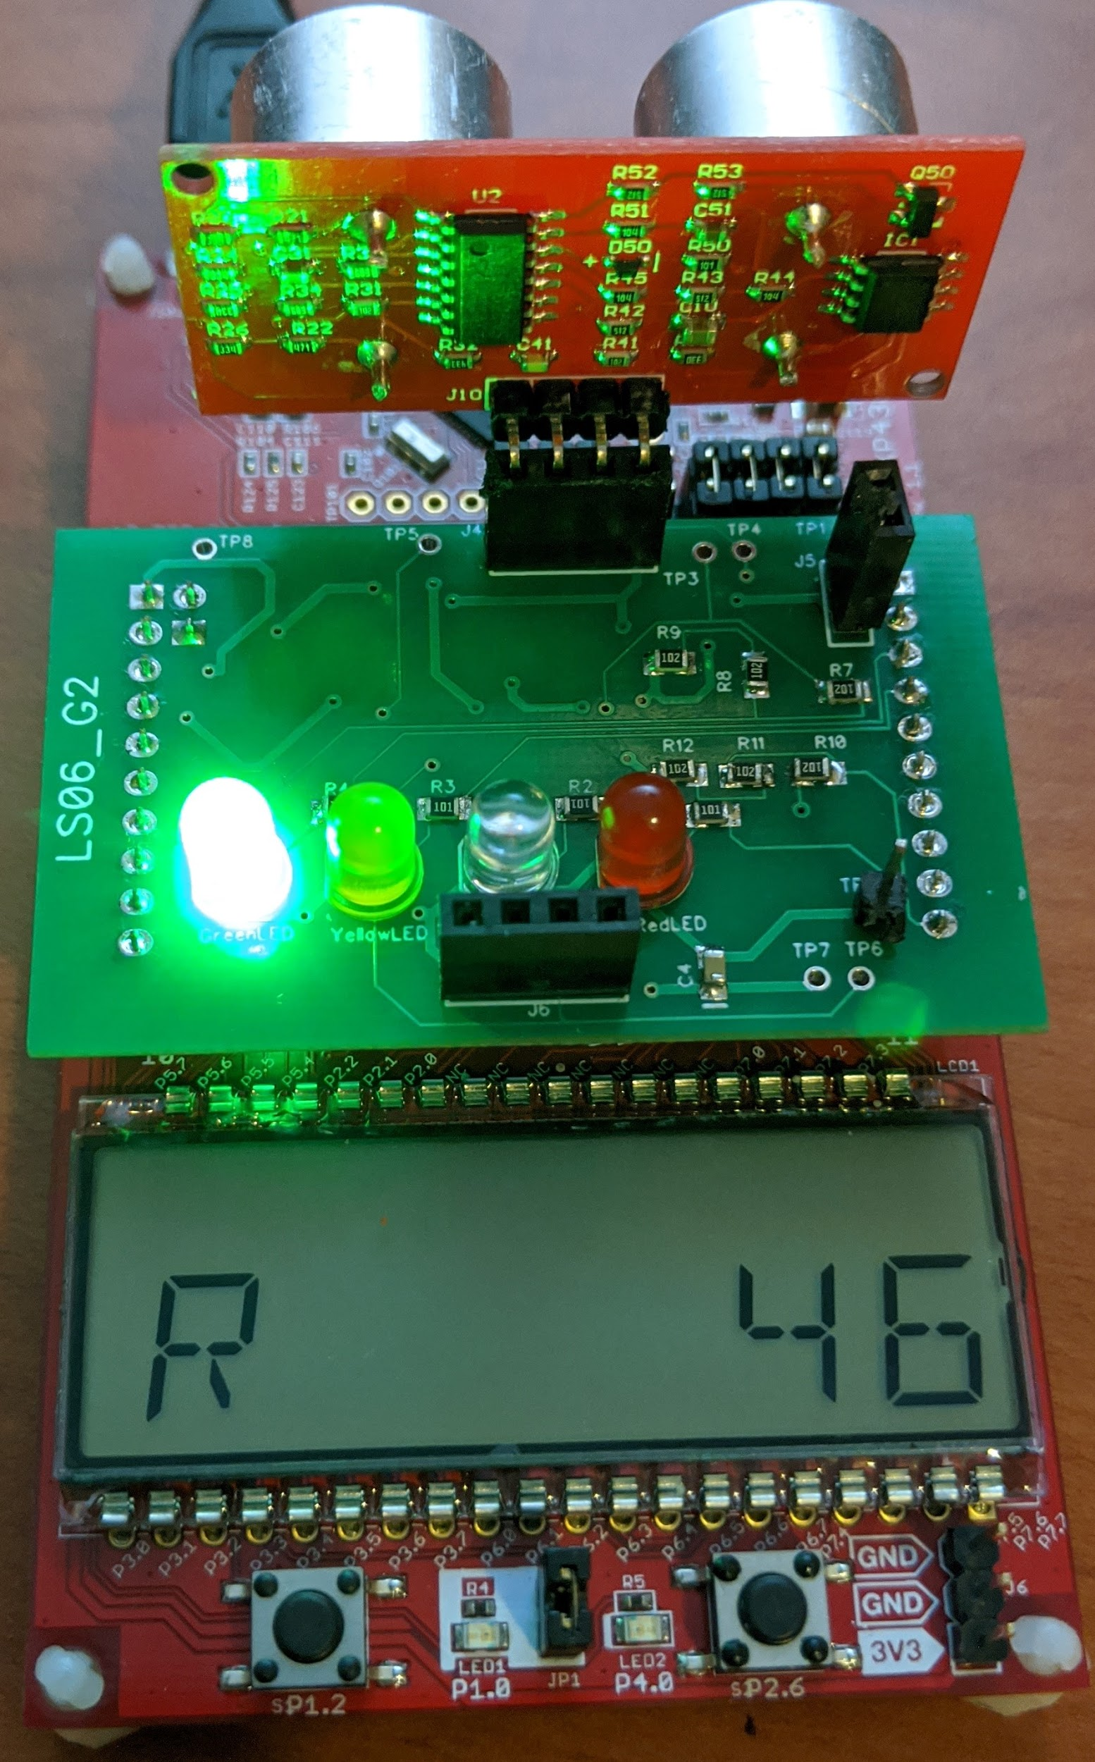
Rear Proximity Thresholds : LEDs
1. Red
2. Orange
3. Yellow
4. Green
Notes:
Adding design goals and how we achieved them

Slide 5

Forward Proximity Thresholds: Buzzer
1. Quadruple beep
2. Double beep
Notes:
Adding design goals and how we achieved them

Slide 6
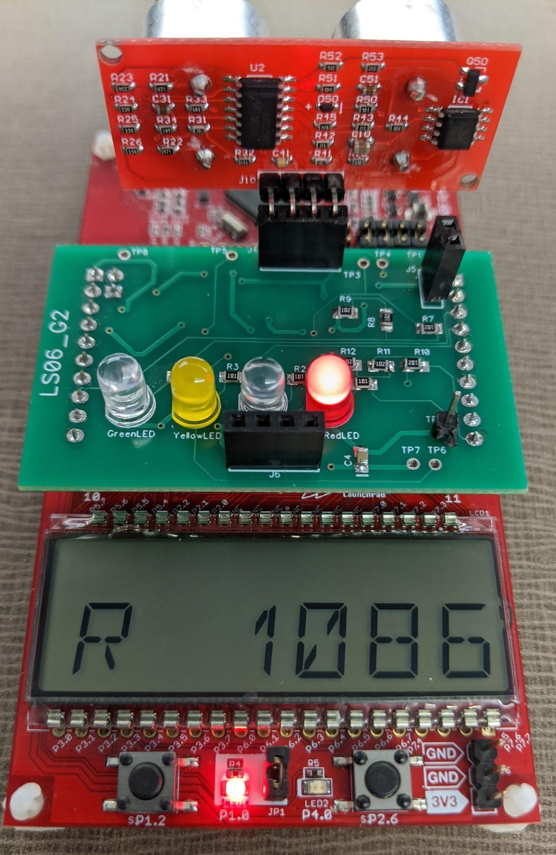
Changing Proximity Thresholds: Setup Mode
PB 1 (left) interrupt switches between setup and user mode
MCU LED on indicates setup mode
PCB LEDs indicate which threshold it is currently trying to set
Press PB 2 (right) to lock in that threshold, and it’ll move onto next threshold
Once all thresholds set, it’ll exit setup mode
Notes:
Adding design goals and how we achieved them

Slide 7
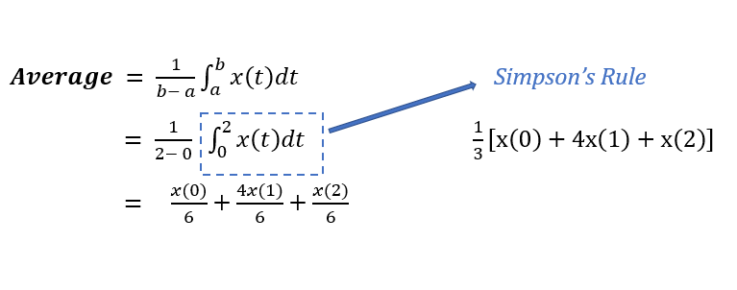
Smoothing sensor readings: Simpson’s Rule
Recall from ECE 204:
Notes:
Adding design goals and how we achieved them

Slide 8
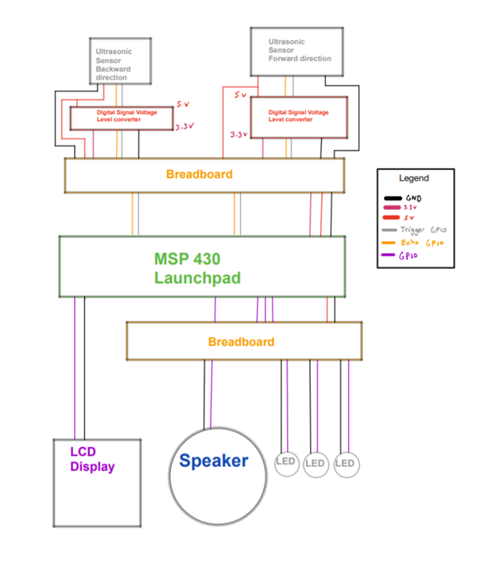
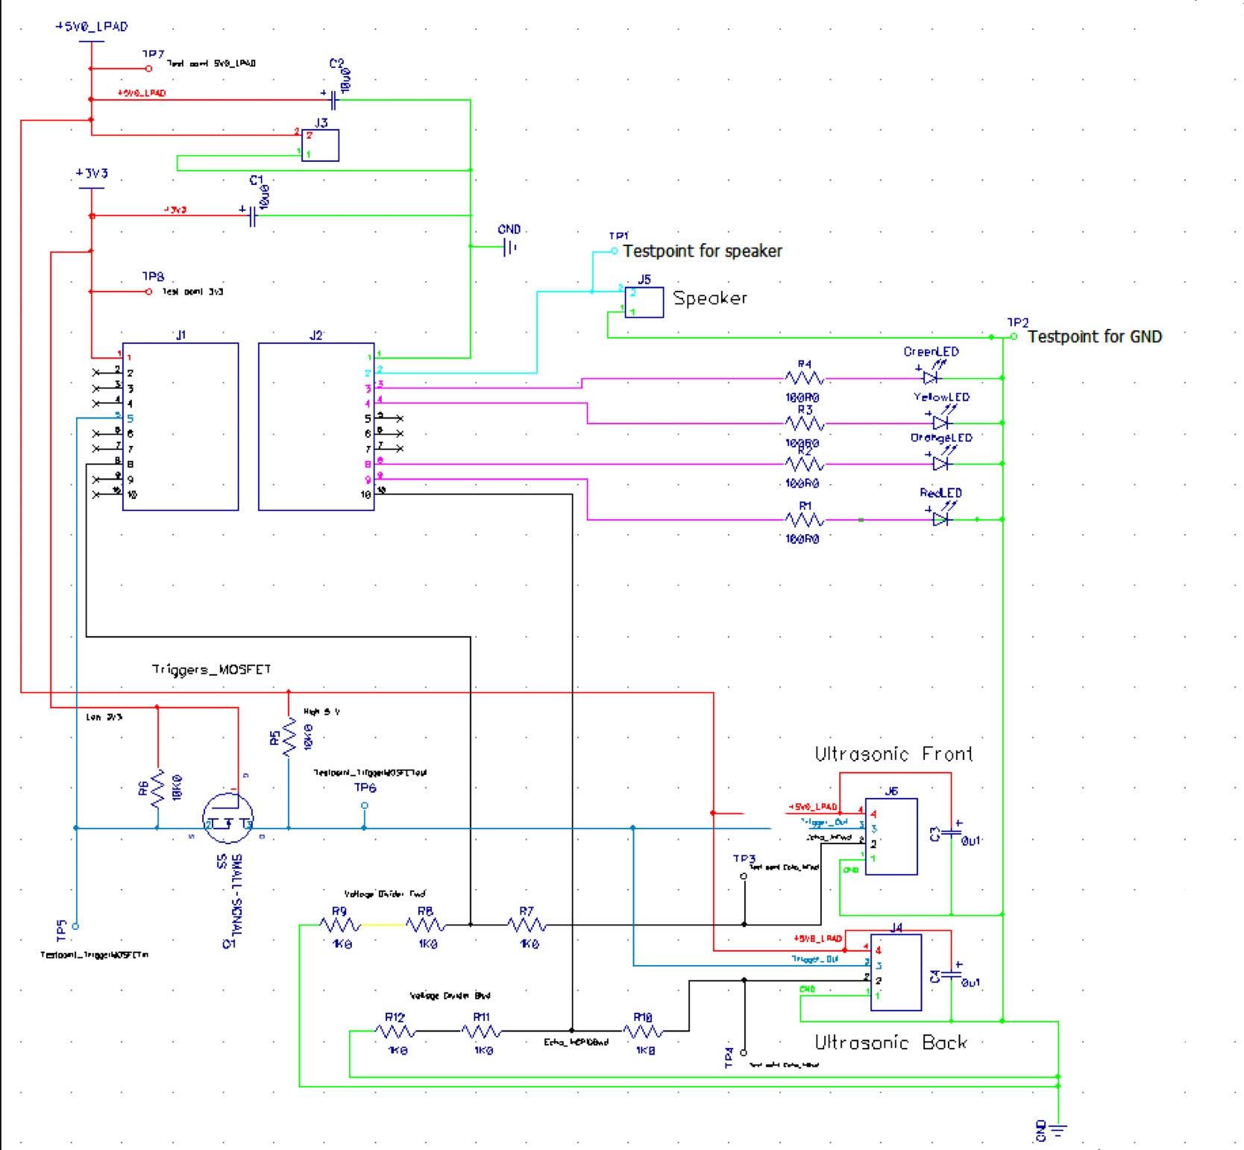
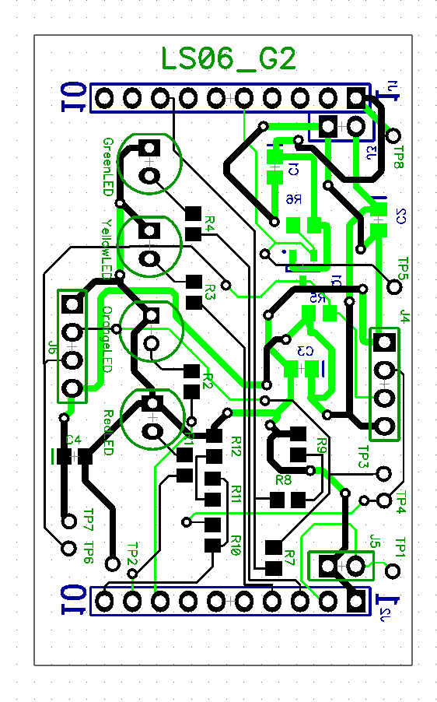
Progression of Hardware Design
Feasibility Model Diagram
Prototype Model Schematic
PCB Production Model
Notes:
We first started off with our Feasibility Model which is just a general idea of how we laid out the wiring from the MCU to the breadboard during this phase we spent a lot of time working on the ultrasonic sensor and getting it to work correctly, this was considerably the hardest phase in our development life cycle, we then worked on our schematic diagram which we had to improve before creating our PCB production model. We then had our PCB production model that incorporated everything from our schematic prototype onto a physical PCB during this phase we spent a lot of time troubleshooting physical issues with our PCB board such as various short circuits and improper soldered components. One issue we had in our final production model is that the BWD sensors on our final PCB model is backwards, so sensors are facing the same direction.

Slide 9
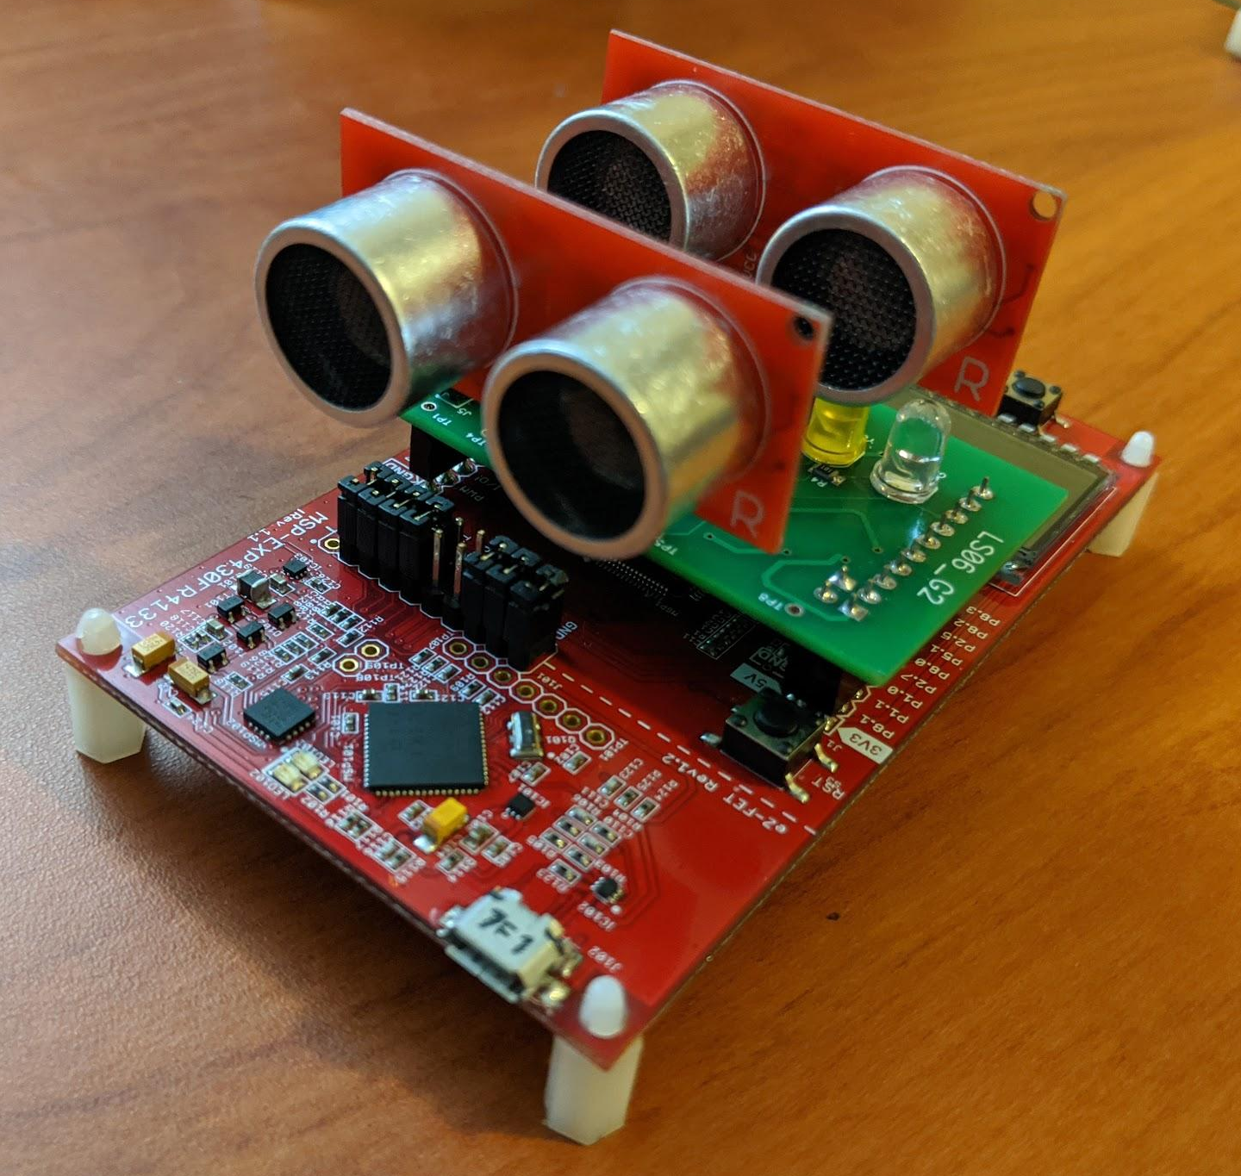
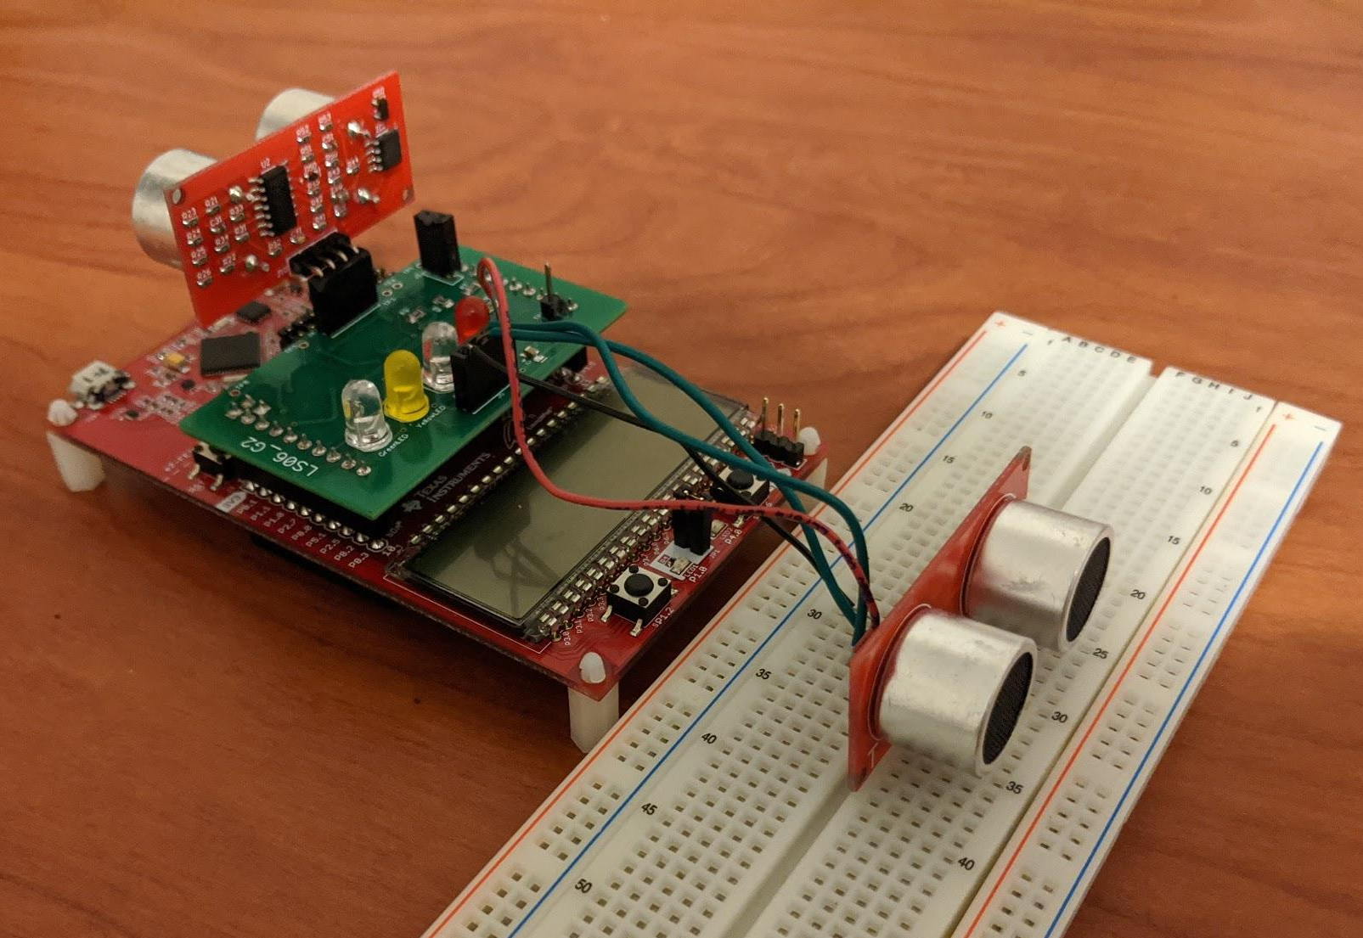
Next Steps and Future Improvements
Fixing the PCB pin arrangement for backwards ultrasonic sensor
Notes:
There are a few future improvements we can make with our project
First is fixing the ultrasonic sensor facing the backwards direction, by fabricating a new PCB that would fix the pin arrangement issue
Second is fixing smaller software bugs

Slide 10


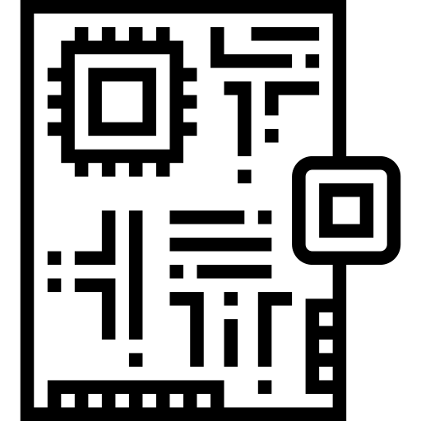
What we learned
Organization
Team Management
Embedded Design
Time management and scheduling time to work was crucial to getting each deliverable done
We designated our workloads based upon our skills and weaknesses.
We learned the life cycle of how Embedded Systems are built and produced
Notes:
Organization was a key component to our projects success. Setting aside time during the weekends and weekdays was crucial to getting our project working as we would be able to tackle and find our issues early and get them done before our deadlines.
Setting roles for each team member was also crucial as we could have team members working on different things concurrently. As Sib worked on schematic and PCB layouts and hardware soldering because of past experience, Waleed worked on getting the project working on the breadboard so during the Production Phase because of previous skill in embedded programming all we had to worry about was debugging PCB hardware issues rather than software issues, schematic issues etc..
We learned a lot about

Slide 11
Tips for future students
Organization
Team Management
Enjoy the course!
Time management, scheduling time, and designating team roles is important
Manage team roles appropriately based on strengths and weaknesses
ECE 298 is a fun course with a lot of different things to learn about
Notes:
Organization is a key component to ECE 298, if you schedule time and tackle your issues early you can get past your roadblocks without worrying about getting into crunchtime.
Setting up and designating team roles is important as well, as it helps streamline the project so team members don’t have to stress on completing everything on time or burning out
Enjoy the course- There’s a lot of stuff to learn about in ECE 298 and most of it self learning but its a challenging new experience for most ECE students

Slide 12
Questions?

Slide 13
References
<div>Icons made by <a href="https://www.flaticon.com/authors/eucalyp" title="Eucalyp">Eucalyp</a> from <a href="https://www.flaticon.com/" title="Flaticon">www.flaticon.com</a></div>
<div>Icons made by <a href="https://www.flaticon.com/authors/freepik" title="Freepik">Freepik</a> from <a href="https://www.flaticon.com/" title="Flaticon">www.flaticon.com</a></div>
<div>Icons made by <a href="https://www.flaticon.com/authors/freepik" title="Freepik">Freepik</a> from <a href="https://www.flaticon.com/" title="Flaticon">www.flaticon.com</a></div>
Notes:
some references for images used

